Slide 1
Introduction to VCS Version 4 Consultation
Sam Hoffer, Manager: VCS & CCB Programs
John Holler, Senior Program Officer

Slide 2
Agenda
Background and consultation format
Introduction to VCS Version 4 proposals
Q & A

Slide 3
Background
VCS Version 3 operating since March 2011
Significant developments since that time:
Paris Agreement
Sustainable Development Goals
Technology advances
Jurisdictional REDD+

Slide 4
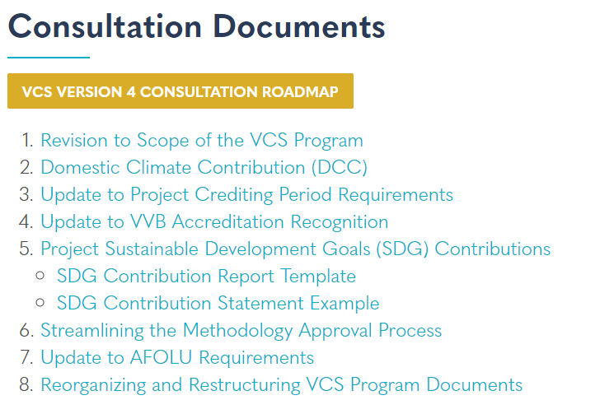
VCS Version 4 consultation format
Consultation will run from 17 May to 16 July
Dedicated consultation webpage houses all consultation materials

Slide 5
Introduction to VCS Version 4 proposals

Slide 6
1) Revision to Scope of the VCS Program
Proposal to exclude certain project types from future eligibility under the VCS Program
Based on recognition that certain project types are moving beyond their reliance on carbon finance
Extensive literature review conducted to assess:
Impact of carbon revenue on an activity finances
Prevalence or common practice of the activity
Current or prospective regulatory support for certain activities
Verra identified project activities which, in a significant proportion of cases, no longer depend on carbon finance
Verra appreciates that this approach will lead to the exclusion of certain truly additional projects

Slide 7
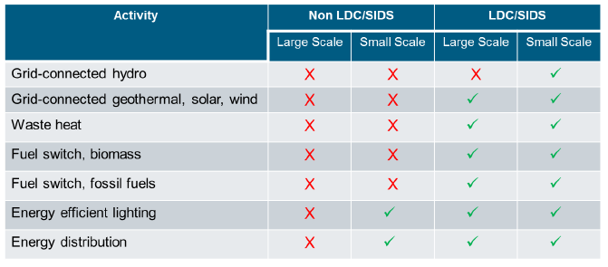
1) Revision to Scope of the VCS Program, cont.
* Registered projects and projects that apply for registration within 3 months of a revision to the scope of the VCS Program will/would remain eligible under the VCS Program for the entirety of their renewable crediting periods. Following such grace period, the project types listed in the table above would no longer be eligible to request registration.

Slide 8
2) Domestic Climate Contribution (DCC)
Proposal to create new unit under the VCS Program to promote domestic climate action and address double counting risks
Based on recognition that:
Post-2020, double counting risks may become more prevalent
Projects may be required to secure corresponding adjustments from host countries
Host countries may not be willing to make such adjustments

Slide 9
2) Domestic Climate Contribution (DCC), cont.
DCCs differ from VCUs only in respect of the claim that an end user can make:
Contribution to host country NDC, rather than an offset
Avoids double claiming risk since emission reduction “remains in-country”
Process for generating DCC same as for VCU
DCCs will act as a complement to VCUs
Verra appreciates this is would be a shift in messaging for end users, but wants to start a conversation around the subject

Slide 10
3) Update to Project Crediting Period Requirements
Proposal to revise non-AFOLU crediting period requirements to provide projects an option of:
7 years, twice renewable
10 years, non-renewable
Based on recognition that current crediting periods are likely too long:
Non-AFOLU projects likely do not require 30 years of carbon finance support
Circumstances affecting baseline scenario and regulatory surplus likely change on shorter timescales
Proposal would only apply to new projects

Slide 11
4) Update to VVB Accreditation Recognition
Proposal to only recognize VVBs accredited to ISO 14065 by an accreditation body that is a member of the IAF
Based on recognition that allowing multiple forms of VVB accreditation has led to:
Inconsistency with respect to levels of accreditation oversight of VVBs
Imbalance in the level of participation with and ability to provide VVB performance feedback to different accreditation bodies

Slide 12
4) Update to VVB Accreditation Recognition, cont.
Verra envisions that it will sign MOUs with various IAF members, as it has already done with ANSI and SCC, or work directly with IAF
This would allow Verra to consistently communicate and provide VVB performance data to accreditation bodies
Effective date of 1 January 2020 proposed, meaning VVBs would only be eligible where they have IAF accreditation by this date

Slide 13
5) Project SDG Contributions
Proposal to create an optional Project SDG Contributions Report for projects to highlight SDG contributions
Based on recognition that:
SDGs have generated much interest amongst corporates, investors, NGOs, development banks, governments, etc.
Projects are already reporting against the SDGs, but in an inconsistent and unstandardized way
Envisioned that Verra staff will be responsible for report reviews, and will produce a Project SDG Contributions Statement

Slide 14
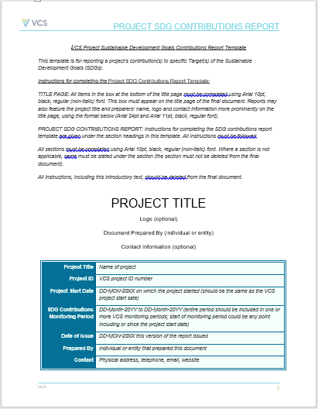
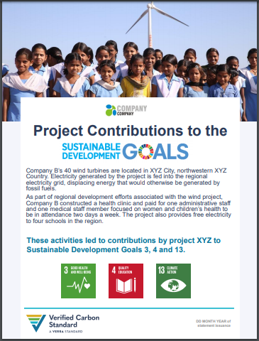
5) Project SDG Contributions, cont.

Slide 15
6) Streamlining Methodology Approval Process
Proposal to remove the first VVB assessment from the methodology approval process
Based on recognition that:
Verra staff have become more involved in methodology approval process (MAP) to provide editorial and technical guidance
Has led to more consistent methodologies and resolution of technical issues at an early stage
Adds time and cost

Slide 16
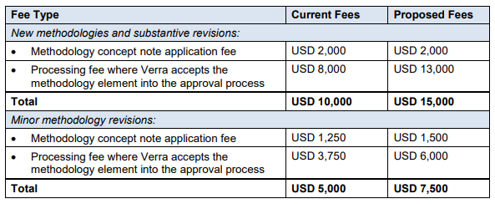
6) Streamlining Methodology Approval Process, cont.
Verra staff reviews will continue to focus on ensuring that methodologies are well-structured and that there are no major inconsistencies with VCS rules
Update to method of VVB selection
New proposed fees

Slide 17
7) Updates to AFOLU Requirements
Proposal to update/introduce a number of requirements under the AFOLU Requirements:
Standardized reference region selection criteria
Optional default non-permanence risk ratings
Mechanism for identifying potentially inactive projects
Strengthened local stakeholder engagement
REDD+ projects nesting in jurisdictional REDD+ programs

Slide 18
8) Reorganizing VCS Program Documents
Proposal to restructure and reformat VCS program documents to:
More clearly delineate project-level and methodology-level requirements in separate documents
Restructure text to better distinguish descriptive text from requirements
Removing outdated information
Based on recognition that navigating program documents can be challenging
Please provide other recommendations

Slide 19
Q&A session
We’ve been tracking your questions and will respond to those now
Please continue to submit questions; we’ll continue responding within the time allotted
Questions after today? Submit those to secretariat@verra.org

Slide 20
Thank you!
Sam Hoffer, Manager: VCS & CCB Programs
shoffer@verra.org
John Holler, Senior Program Officer
jholler@verra.org

